Slide 1
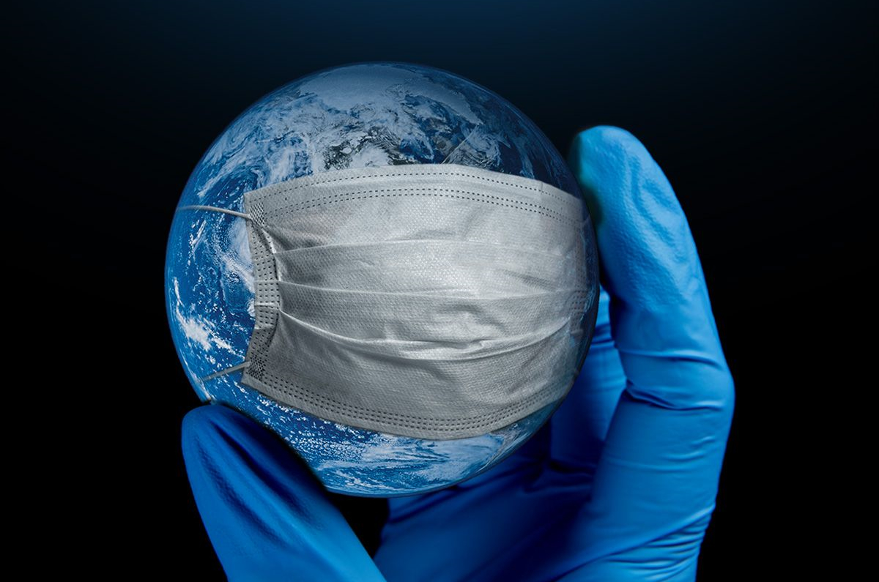
Health and Diseases
Which changes are likely to occur in this field as a result of the climate change and how can we meet these changes in our countries? Who could be asked for more information?

Slide 2
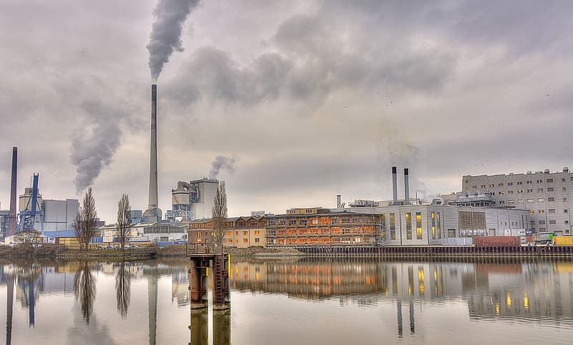
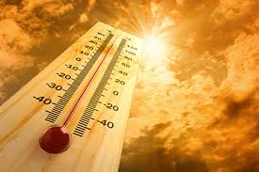
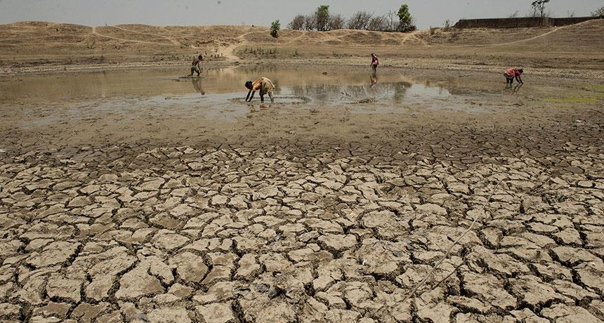
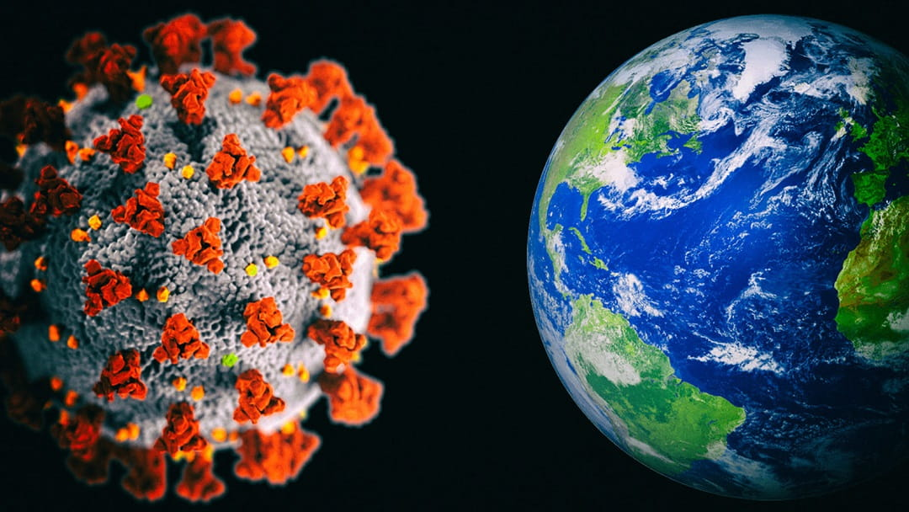
Global Warming poses a threat to our health because of increased mortality and mordibility, this is due to bad air quality, rising temperatures, more extreme weather events and more incidences of food- and water- borne allergens and pathogens.
We of course have the raging Covid-19 as well, but there is no evidence that this virus comes from climate change or global warming.

Slide 3
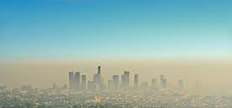
Air Pollution
Climate change is projected to harm human health by increasing ground-level ozone and/or particulate matter air pollution in some locations. Ground-level ozone (a key component of smog) is associated with many health problems.

Slide 4
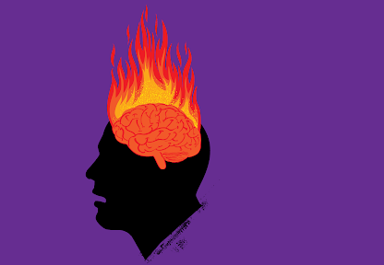
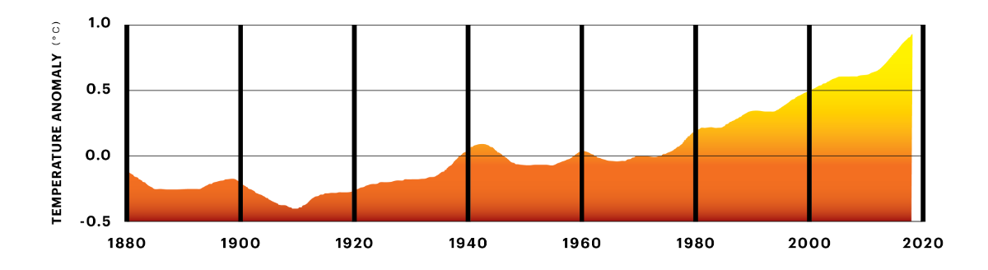
Rising Temperatures
The world has suffered dramatical increases in death rates during heat waves. Deaths result from heat stroke and other diseases that result from high temperature. Extreme summer heat is increasing, and climate projections indicate that extreme heat events will be more frequent and intense in coming decades.

Slide 5
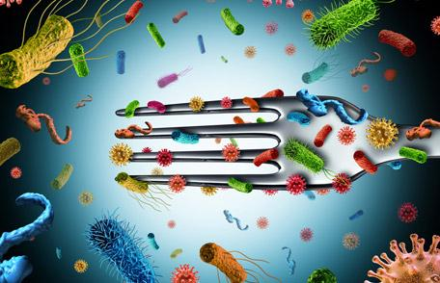
Food and Waterborne Diarrheal Disease
In general, diarrheal,diseases,are more common when temperatures are higher, though patterns differ by place and pathogen.

Slide 6
How to handle these problems?
What can we do?
for example, supporting sustainable agriculture, eating less meat, and reducing food waste, would see global emissions from agriculture fall significantly.
we could use better stoves and heaters ventilation in every home and this could help to reduce air pollution.
more use of renewable energy, better urban planning and reforestation.

